Slide 1
An introduction to antigenic cartography

Slide 2
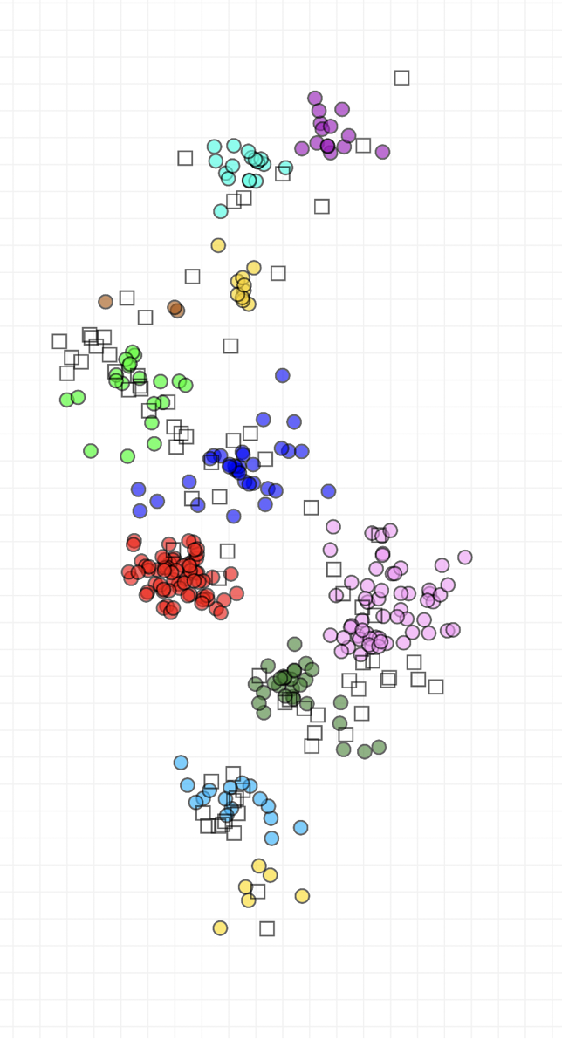
What do you get from an antigenic map?
Ease
Anyone can interpret it!
Accuracy
Based on multiple measurements patterns seen in the map are less biased by random assay noise
A better overview
Features such as the trajectory of evolution through antigenic space can be seen more clearly
Quantification
Antigenic similarity between strains can be quantified, allowing us to explore how different characteristics (isolation data, genetic characteristics etc.) relate to antigenic differences
Predictions
Expected reactivity and immunity can be predicted based on antigenic position

Slide 3
From an assay to a map

Slide 4
How to get from HI data to antigenic distance and positions in an antigenic map?

Slide 5
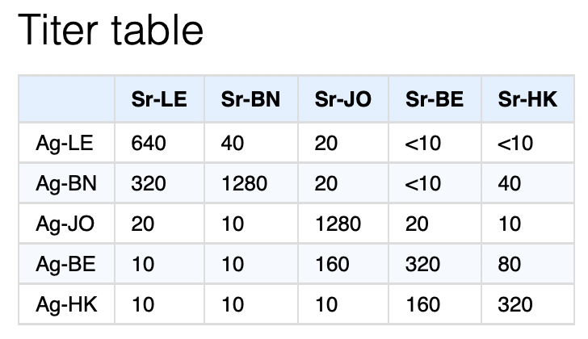
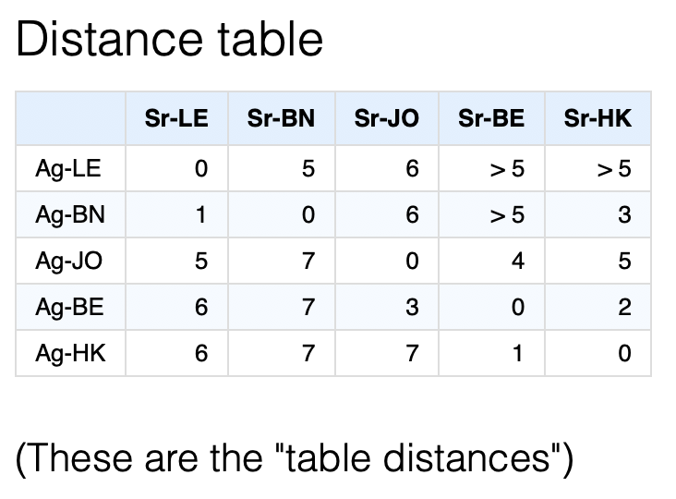
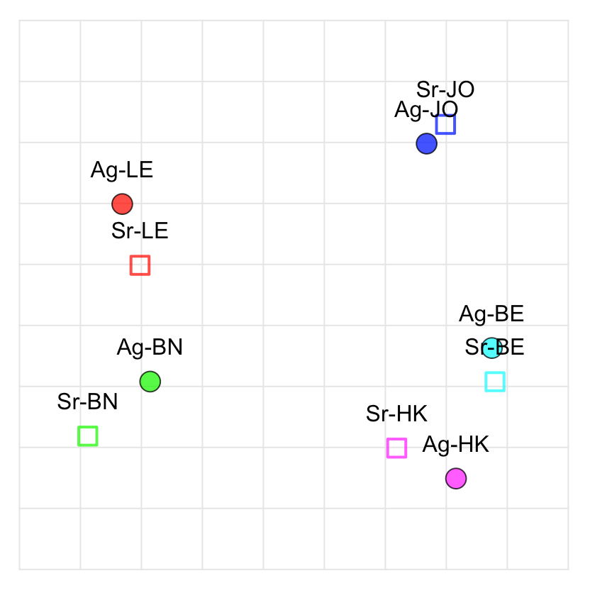
Antigenic map

Slide 6
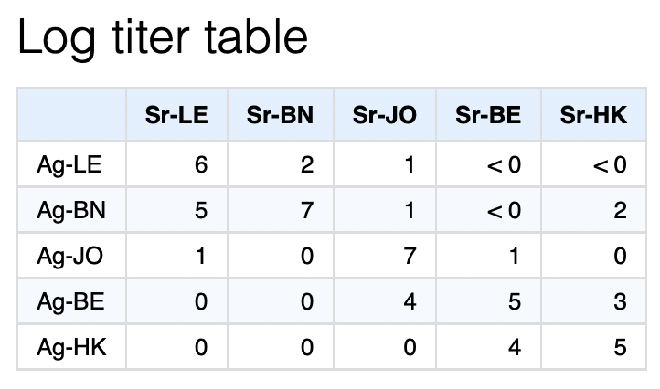
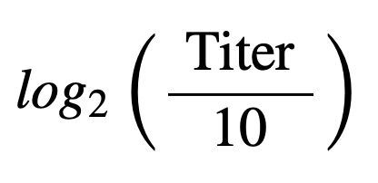
Titer data - log titer data
Why do we need to convert to the log scale?

Slide 7

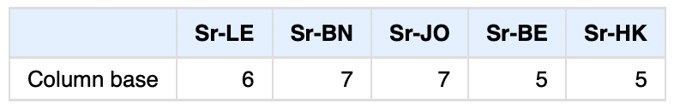
Log titer data - distance data

Slide 8
Minimum column bases
“none”
Minimum column basis

Slide 9
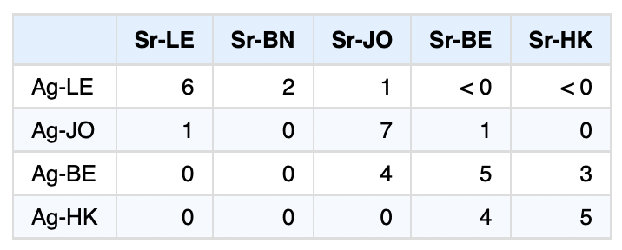
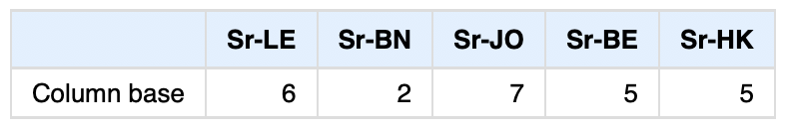
Minimum column bases
“none”
“none”
Minimum column basis

Slide 10
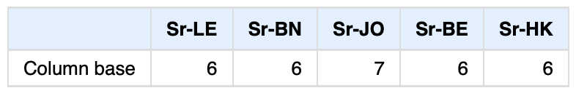
Minimum column bases
“none”
“none”
“640”
Minimum column basis

Slide 11
Distance data – antigenic map

Slide 12
Distance data – antigenic map
Multidimensional scaling!
A classic problem, but we have some complications in our case:
Greater than distances
Missing distances

Slide 13
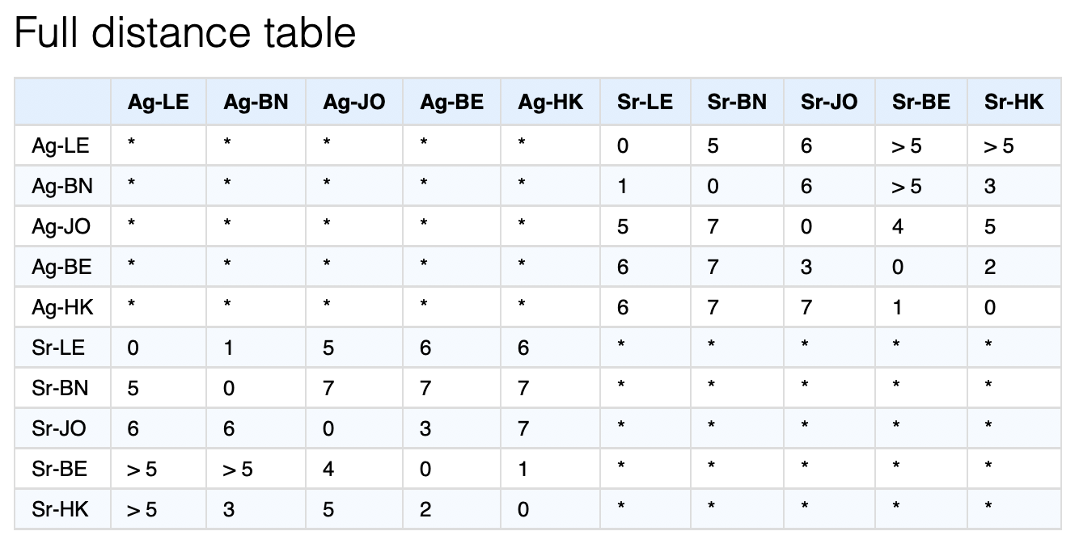

Slide 15
Distance data – antigenic map
The MDS optimizer
Performs tricky mds for you, but it’s not perfect
Optimization steps
Start antigen and serum points in a random position in 5 dimensions
“Relax” and use an optimizer to move points into optimal position
Reduce number of dimensions
Relax and optimize point positions again
Repeat until desired number of dimensions reached
You’ll find that different random starting points lead to different solutions so you often need to repeat the optimization process many times

Slide 16
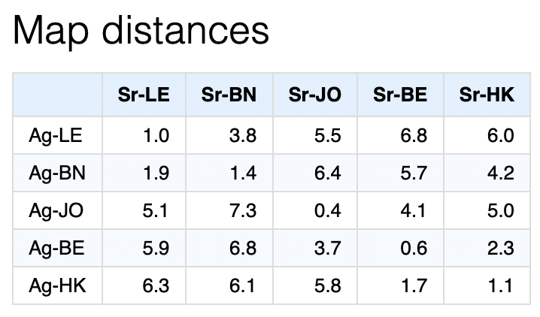
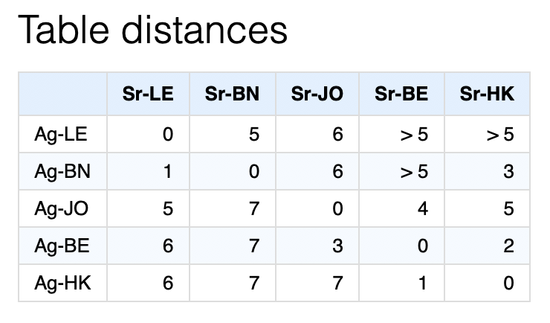
Antigenic map

Slide 17
Stress calculations
Point stress and map stress
Quantifies how well distances in the map match “measured” distances in the distance table.
For each measurement:
For a table distance Iike > 5, table distance is assumed to be 6 and stress is set to 0 if map distance is > 6.

Slide 18
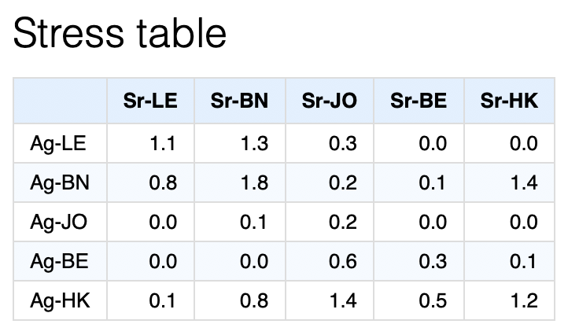
Stress calculations
The optimizer tries to position the antigens and sera to minimize the sum of stress in this table

Slide 19
How to know if your map is any good?
Checking the optimization (consistency, table vs map distances)
Checking coordination of points (blobs)
Checking how well it fits your data (stress)
Checking how well it predicts missing data (cross-validation)
Checking stability with noise (bootstrapping)

